Slide 1
Evolving Test Cases with Genetic Algorithms
Keenan Herbe

Slide 2
Motivation
Manual tests miss edge cases (poor coverage)
-> Undetected bugs
-> Technical debt
Random testing is simple but inefficient

Slide 3

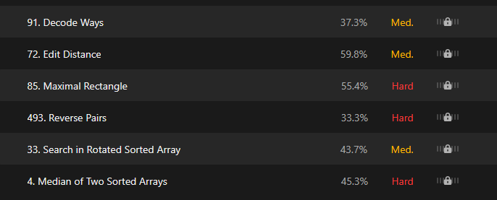
Project Goal
Focus: Apply genetic algorithm to LeetCode algorithmic problems
Compare GA-generated inputs vs random test generation
Target metrics: code coverage + logic bug detection

Slide 4
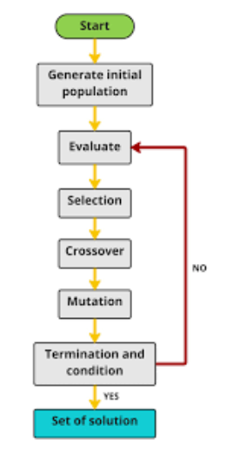
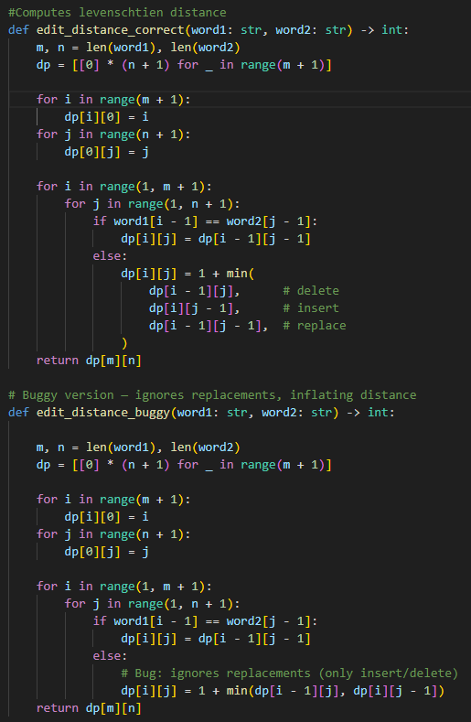
Genetic Algorithm
Correct & buggy answer implementations
Evaluator compares outputs to measure failures
Uses coverage library to measure coverage
Chromosome: Encoded inputs
  (arrays, numbers, strings)
Fitness:
  Coverage % + (k * bugs detected)
Operators:
  Selection (tournament),
  Crossover (2-point),
  Mutation
Population:
  Evolve inputs over generations → more likely to hit tricky cases

Slide 5
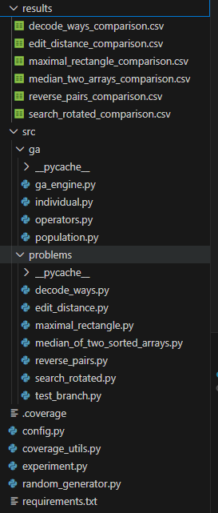
Implementation
coverage_utils.py: Evaluator function, Coverage function
random_generator.py: Problem-specific random input generation
experiment.py: Orchestrates GA vs random testing, records results
Modular: can add new problems by specifying correct/buggy + input generator

Slide 6
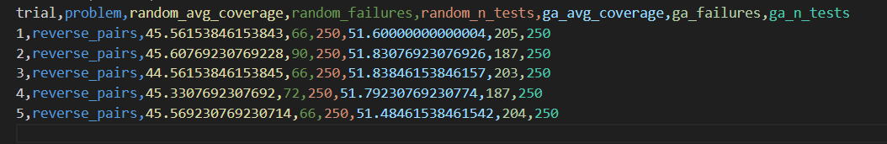
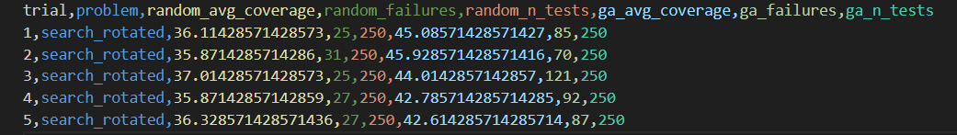
Evaluation of Results

Slide 7
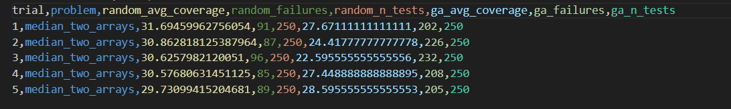
Fine tuning

Slide 8
Thank You

